Slide 1

Project Presentation & Demonstration on “Title: Gym Database Management System”
Students:
Nitheesh Shetty (1RN19CS091)
Nitish K (1RN19CS092)
Rakshith BK (1RN19CS108)
Rajatha Bangera
(1RN20CS411)
Guide:
Prof. Vidya.Y.
Asst. Prof. Dept. of CSE, RNSIT
Guide(External-optional):
Name:
Designation & Organization
Department of Computer Science and Engineering
RNS INSTITUTE OF TECHNOLOGY
2021-22

Slide 2
CONTENTS
INTRODUCTION
Problem Statement
Existing System and Limitations
Proposed system
REQUIREMENTS
Functional Requirements
Non-functional Requirements
Hardware & Software Requirements
SYSTEM ARCHITECTURE/BLOCK DIAGRAM
System architecture
Data Flow Diagrams (DFD)/ Flow charts
Class diagrams
Sequence diagrams
( Note: Details of entire project)
DETAILED DESIGN (Module wise)
Flow charts
Dataflow diagram
Entity-Relationship diagram
Libraries used / API’s
IMPLIMENTATIONS (Module wise)
Algorithm/Methods/Pseudo code
RESULT ANALYSIS
Unit testing
Integration testing/System Testing
Snapshots
CONCLUSION
Conclusion
Future work to be carried out
REFERENCES

Slide 3
INTRODUCTION
Problem Statement
The main aim of creating a gym management system is to implement the various facilities which are provided by Database Management System such as data storage, maintenance, security of data and to eliminate the data redundancy. To store the records of members who are a part of the gym and to allow the admin to access, modify, insert and delete the records of members

Slide 4
INTRODUCTION
Existing System and Limitations
The existing system is not as user friendly as the proposed system
Time consuming and requires a lot of manual calculations
The data is also not secure can be mishandled due to lack of data security

Slide 5
INTRODUCTION
Proposed system
Keeping in mind the various limitations of the existing systems we have tried to develop the proposed system as follows
The Proposed system provides proper security and manual work
Minimize time needed for the various processing
Greater efficiency
Better Service
User Friendly and interactivity

Slide 6
REQUIREMENTS
Functional Requirements
The system runs on apache server so the server must have the latest version of apache installed in it
MySQL Database is used for storing and retrieving the data
HTML is used to create the layout of the webpage
CSS is used for designing and making the webpage more responsive
PHP is used for backend which takes the data from html form and stores
it in the database

Slide 7
REQUIREMENTS
Non-functional Requirements
Performance: System should be able to handle multiple users at a time using any web browsers
Reliability: Database updating should follow transaction processing to avoid data inconsistency
Maintainability: It is very easy to maintain the system.
Portability: This system is portable

Slide 8
REQUIREMENTS
Hardware & Software Requirements
Hardware Requirements
The Hardware Requirements are minimal and the program can be run on most of the systems
Processor: Pentium4Processor
Processor Speed: 2.4GHz
Storage Space : 40GB
Monitor Resolution: 1024*768 or 1336*768 or 1280*1024

Slide 9
REQUIREMENTS
Software Requirements
Operating System used: Windows 10
Text Editor: HTML,CSS,JS,PHP
XAMPP Server, PhpMyAdmin, MySQL
Text Editor Used: Sublime Test Editor 3, Notepad++
Browser that supported HTML

Slide 10
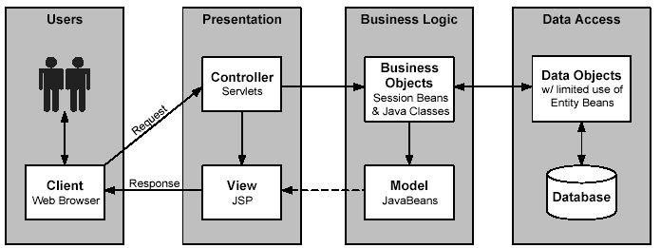
SYSTEM ARCHITECTURE/BLOCK DIAGRAM

Slide 11
SYSTEM ARCHITECTURE/BLOCK DIAGRAM
System architecture: Four Tier architecture is a client–server architecture.
Presentation layer: This is the topmost level of the application. The presentation tier displays information related to services such as browsing merchandise, purchasing and shopping cart contents.
Business layer: Business layer or domain logic is the part of the program that encodes the real world business rules which determine how data can be created, stored, and changed.
Data access layer: A Data Access Layer (DAL) in computer software, is a layer of computer program which provides simplified access to data stored in persistent storage.

Slide 12
SYSTEM ARCHITECTURE/BLOCK DIAGRAM
This kind of model could be implemented by creating a class of data access methods that directly reference a corresponding set of database stored procedures.
Control layer: The control layer is responsible for the communication between business and presentation layer. It connects logic and data with each other and provides a better connectivity and separation between layers.

Slide 13
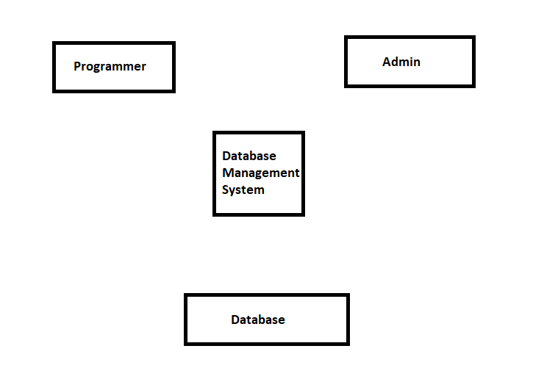
Data Flow Diagrams

Slide 14
IMPLEMENTATION
Pseudo code
<!DOCTYPE html>
<html>
<head>
<title>Freeman's Fitness</title>
<meta charset="UTF-8">
<meta http- equiv ="X-UA-Compatible" content="IE=edge">
<meta name="viewport" content="width=device-width, initial-scale=1.0">
<link rel="stylesheet" type="text/css" href="css/style.css">
</head>
<body>
<div class="logo">
<a href="#"><img src="images/gym.png" width="12%" alt="Freeman's Fitness"></a>
<nav class="navbar">
<a href="index.html">HomePage</a>
<a href="about.html">About</a>
<a href="fitnesscenter.html">Fitness_Center</a>
<a href="contact.html">Contact</a>
<a href="trainers.html">Trainers</a>
<a href="authors.html">Authors</a>
</nav>
</div>

Slide 15
IMPLEMENTATION
<div class="middle">
<p>A new way to build a healthier lifestyle</p>
<h2>IT'S ALL ABOUT WHAT YOU</h2>
<h2>CAN ACHIEVE</h2>
<p>Join the Freeman's Fitness and</p>
<p>empower yourself to make the changes you need to make</p>
<div class="btn">
<a href="register.html"><button class = "btn1“ > Register </button></a>
<a href="#"><button class="btn2">Learn More </button> </a>
</div>
</div>

Slide 16
IMPLEMENTATION
Php snippet to connect register with database
<?php
$insert = False;
$servername = "localhost";
$username = "root";
$password = "";
$dbname = "gymdb";
$conn = new mysqli($servername,$username,$password,$dbname);
if(!$conn)
{
die("connection to this database failed due to ".mysqli_connect_error);
}
$GymId = $_POST["GymId"];
$FullName = $_POST["FullName"];
$Age = $_POST["Age"];
$DateOfJoining = $_POST["DateOfJoining"];
$Email = $_POST["Email"];
$PhoneNumber = $_POST["PhoneNumber"];
$Gender = $_POST["Gender"];

Slide 17
IMPLEMENTATION
$sql = "INSERT INTO register ( GymId , FullName , Age , DateOfJoining , Email ,PhoneNumber , Gender) VALUES ( '$GymId‘ , '$FullName‘ ,'$Age‘ , '$DateOfJoining‘ ,'$Email‘ ,'$PhoneNumber‘ ,'$Gender')";
if( mysqli_query ($conn, $sql))
{ echo "<h2 >created successfully</h2>";
$insert = true;}
else
{ echo "Error: ".$sql."<br>".$conn->connect_error;}
include ‘ delete.php ';
$conn->close();
?>

Slide 18
RESULT ANALYSIS
Unit testing: Each module is considered independently it focuses on each part or unit of the software as implemented in the source code.
Integration testing/System Testing: Integration Testing aims at constructing the program structure while at the same time constructing tests to uncover errors associated with interfacing the modules are integrated by using the top down approach. System Testing is executing programs to check logical changes made in it with the intentions of finding the errors.

Slide 19
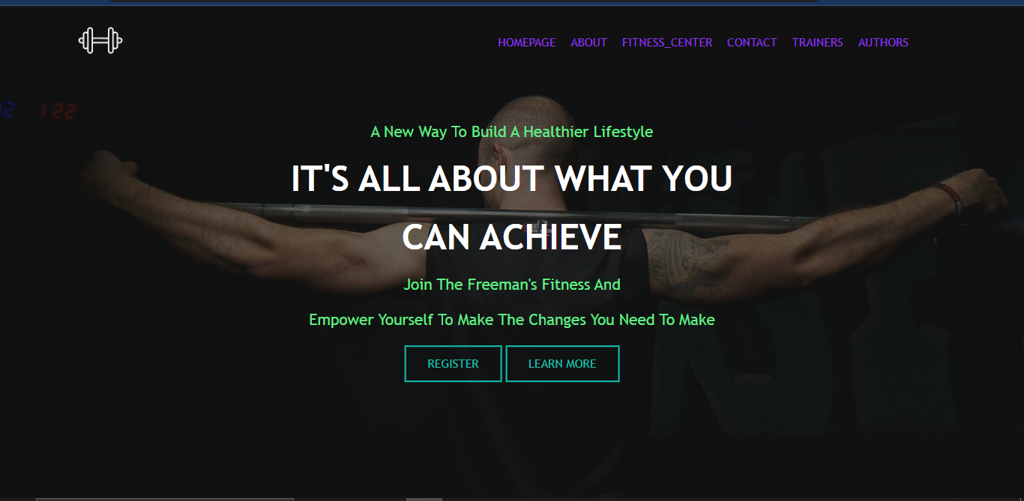
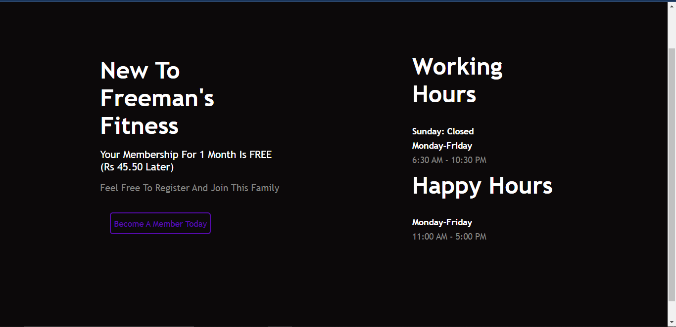
RESULT ANALYSIS
Fig: Homepage
Fig: Contact

Slide 20
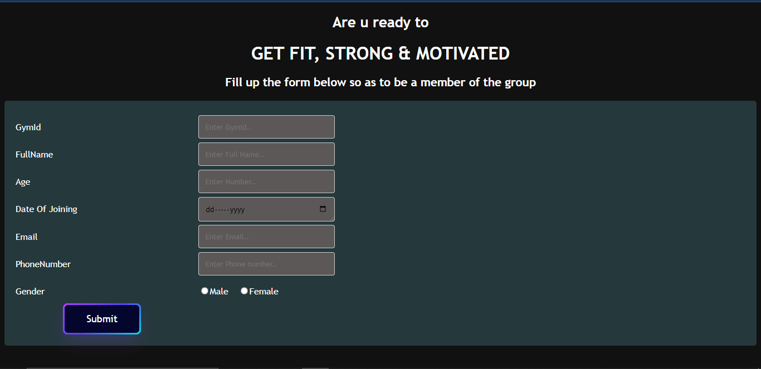
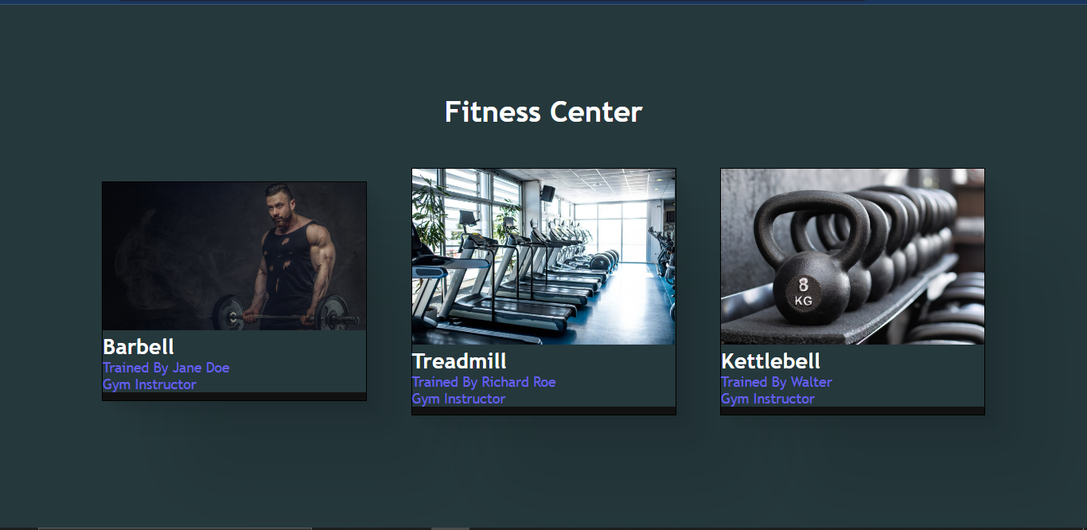
RESULT ANALYSIS
Fig: Fitness Center
Fig Register

Slide 21
CONCLUSION
Conclusion
Existing system limitations:
Time consuming and requires a lot of manual calculations
The data is also not secure can be mishandled due to lack of data security
Cannot meet all the requirements of the admin such as maintaining record and avoiding data redundancy.
Proposed system Advantages
The Proposed system provides proper security and manual work
Greater efficiency
Better Service
User Friendly and interactivity

Slide 22
CONCLUSION
Future work to be carried out
Current status of the project completion (%): Currently the project is around 70-75% complete
Work to be carried out : This project can be further improved by adding more tables, entities and attributes. The frontend of the project can be improvised further using advanced concepts of css, JavaScript, bootstrap and frameworks. Also this has only admin view in it. We can further modify it so as to add the user view where he can book a slot for a gym or check availability.

Slide 23
REFERENCES
[1] https://www.w3schools.com : For HTML,CSS and JavaScript
[2] YouTube : For php connectivity

Slide 24

PROJECT SETUP AND DEMONSTRATION

Slide 25
Suggestions….!

Slide 26
THANK YOU!!!

